Slide 1
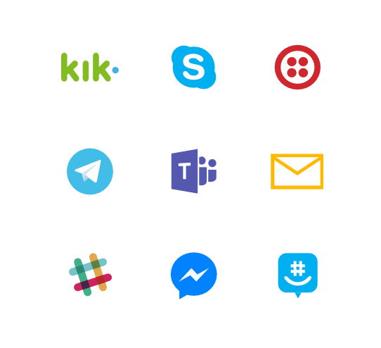
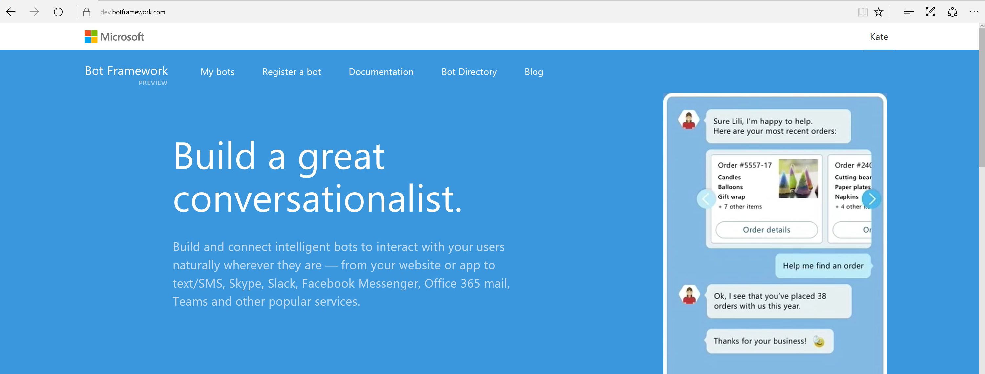
Bot Framework

Slide 2
What makes a bot great?
It is not how “smart” they are
It is not how much natural language they offer
It is not whether they use voice or not
It’s whether it solves the user’s needs in the quickest/easiest way compared to any other option
It’s all about user experience... Just like an app, or a website

Slide 3
The best bots make you type less, not more

Slide 4
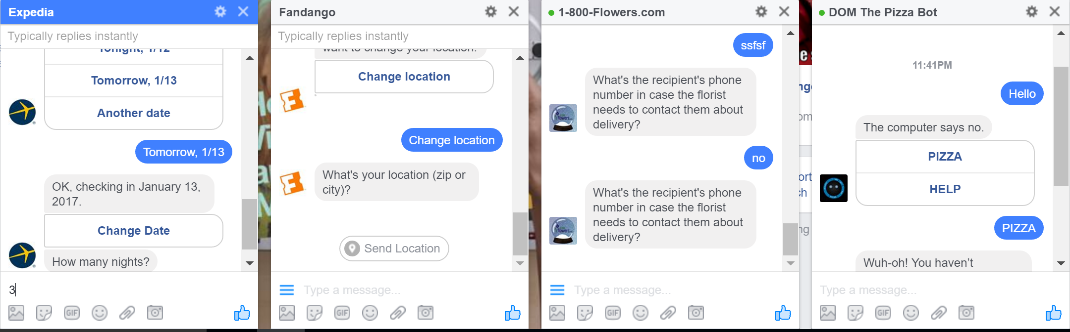
Bots of today (show examples)
https://www.botpages.com/
Notes:
But they were not very useful, just a simple experiment.

Slide 5
Why Bots are like text based Adventure Games

Slide 6
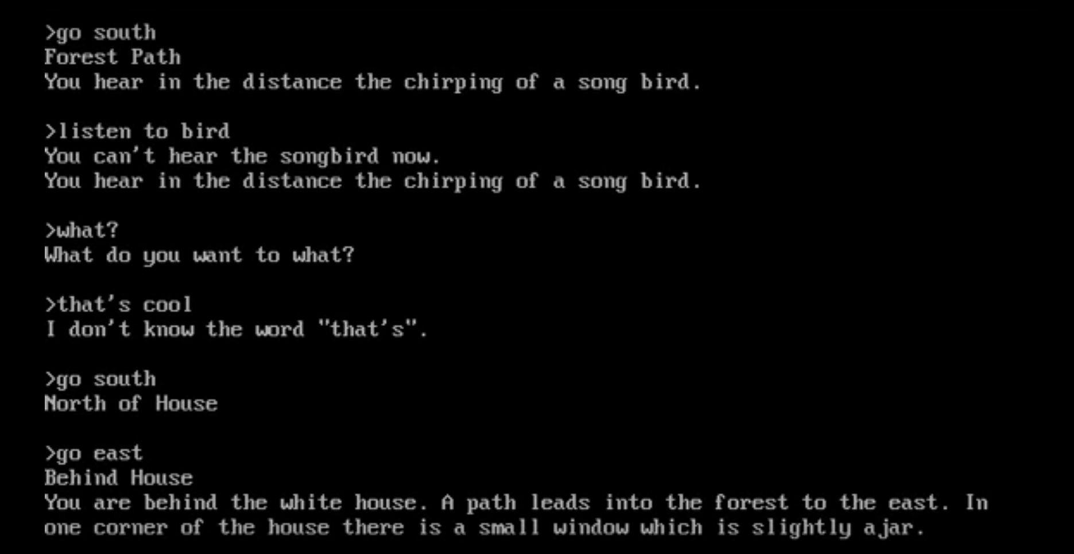

Slide 7
NLP To the Rescue

Slide 8
Why is NLP so hard?

Slide 9
“I saw a man on a hill with a telescope.”
Simple statement?
There’s a man on a hill, and I’m watching him with my telescope.
There’s a man on a hill, who I’m seeing, and he has a telescope.
There’s a man, and he’s on a hill that also has a telescope on it.
I’m on a hill, and I saw a man using a telescope.
Notes:
http://blog.algorithmia.com/introduction-natural-language-processing-nlp/
https://www.youtube.com/watch?v=8S3qHHUKqYk
Tons of stuff here : http://blog.algorithmia.com/introduction-natural-language-processing-nlp/
Human generated language.
spam detection
Millennial speak
On fleek
Bae
Dabbing
Yolo
Throwing Shade

Slide 10
Think about a bot used to answer customers questions about laptops and accessories.
Has my order number 15489 been shipped yet?
How fast is the Surface 3?
Do you sell Acer Laptops and drives?
What kind of a display is on Surface 4
Notes:
http://blog.algorithmia.com/introduction-natural-language-processing-nlp/
https://www.youtube.com/watch?v=8S3qHHUKqYk
Tons of stuff here : http://blog.algorithmia.com/introduction-natural-language-processing-nlp/
Human generated language.
spam detection
Millennial speak
On fleek
Bae
Dabbing
Yolo
Throwing Shade

Slide 11
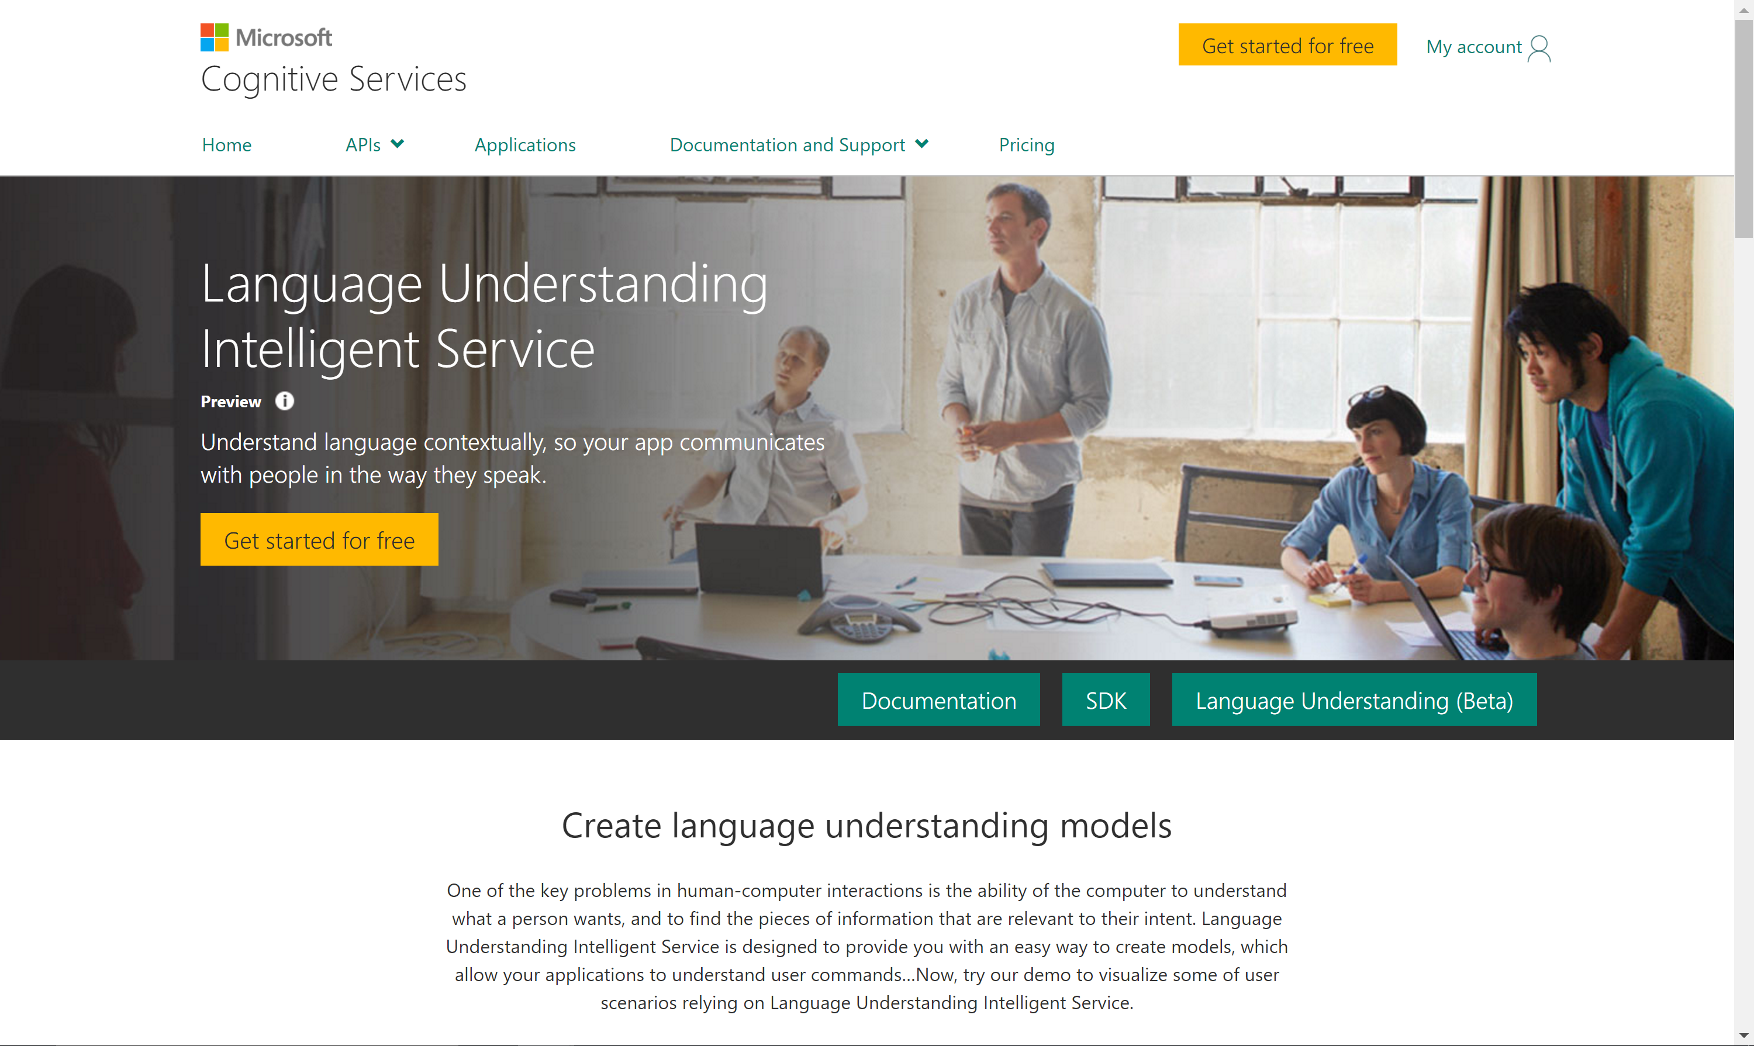

Slide 12
Detour into Cognitive Services

Slide 13
Microsoft Cognitive Services
VISION
SPEECH
LANGUAGE
KNOWLEDGE
SEARCH
Computer Vision
Custom Speech Service (formerly CRIS)
Bing Spell Check
Academic Knowledge
Bing Autosuggest
Emotion
Speaker Recognition
Language Understanding
Entity Linking
Bing Image Search
Content Moderator
Speech
Linguistic Analysis
Knowledge Exploration
Bing News Search
Face
Translator
Text Analytics
Recommendations
Bing Video Search
Video
Web Language Model
QnA Maker
Bing Web Search

Slide 14
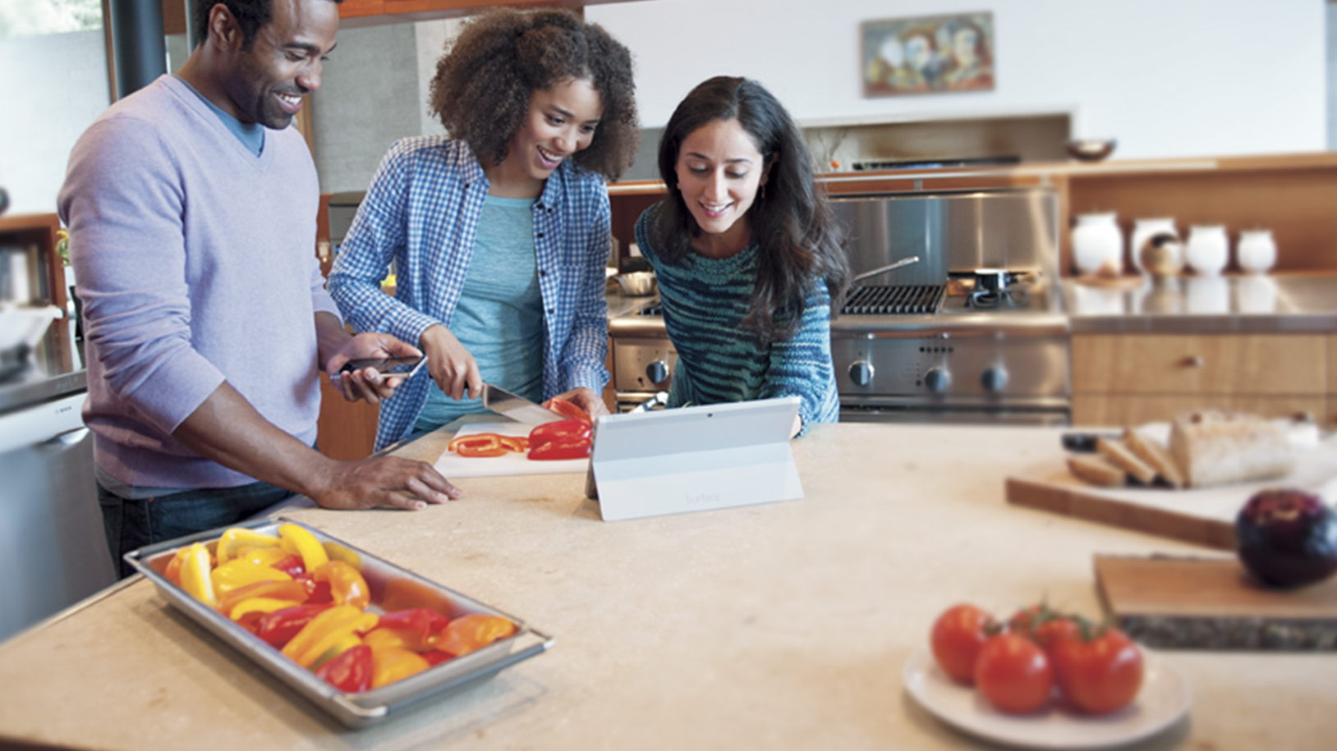
Powerful models
Cognitive Services models are trained using the same deep learning and machine learning techniques that power many products across Microsoft

Slide 15
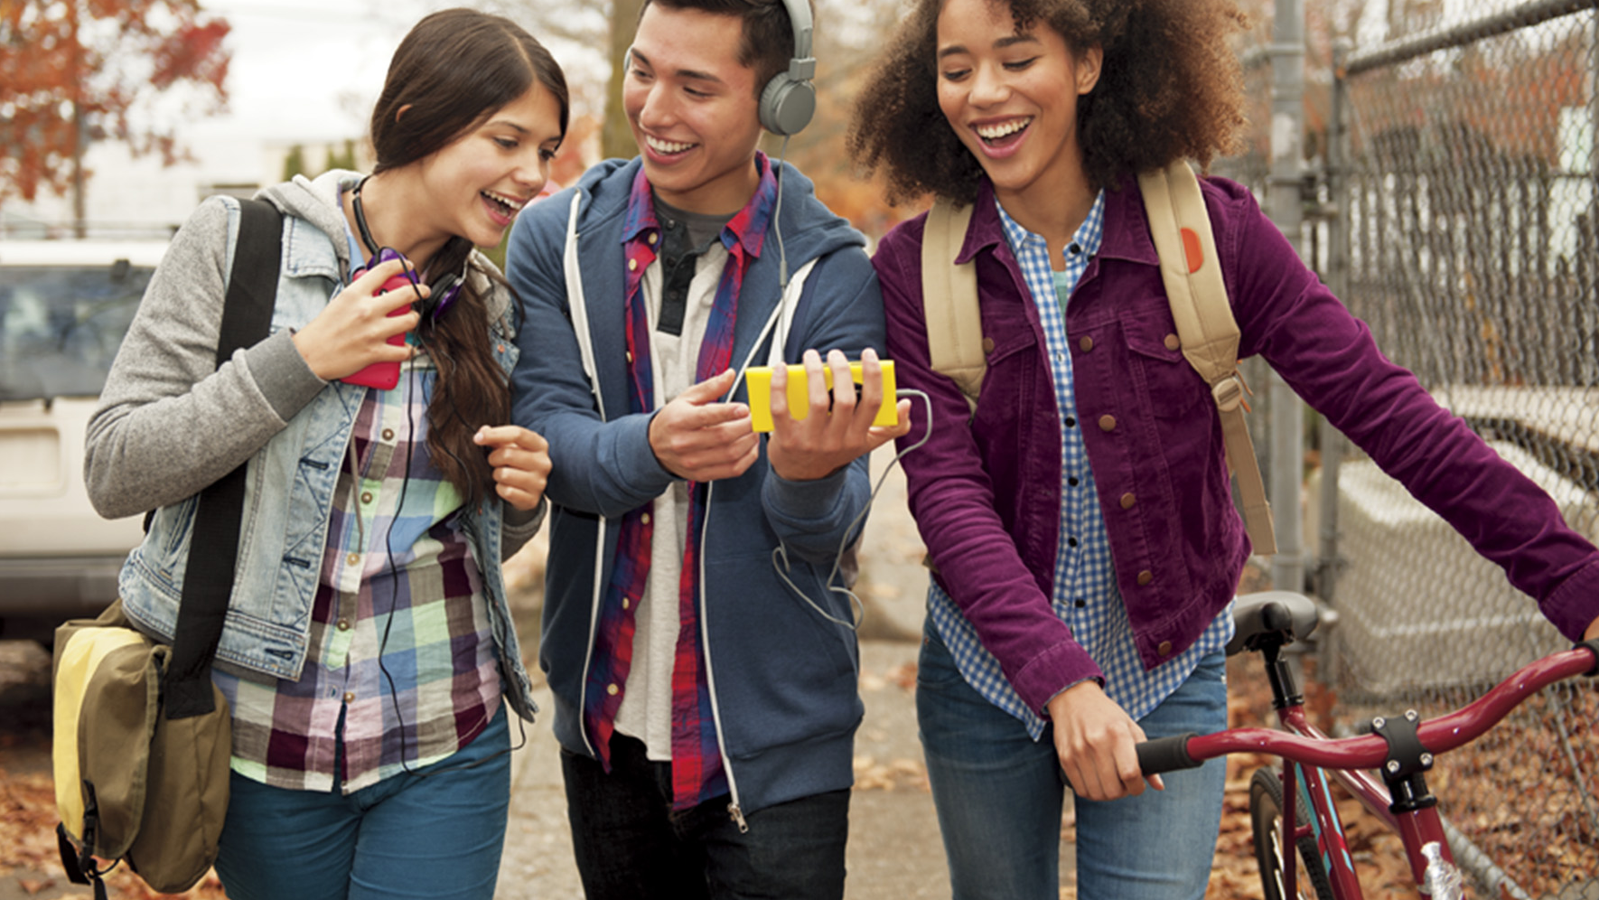
Easy to use
Microsoft Cognitive Services allows you to focus on your application by easily including these services across platforms through simple REST APIs

Slide 16
Vision
Computers that see

Slide 17
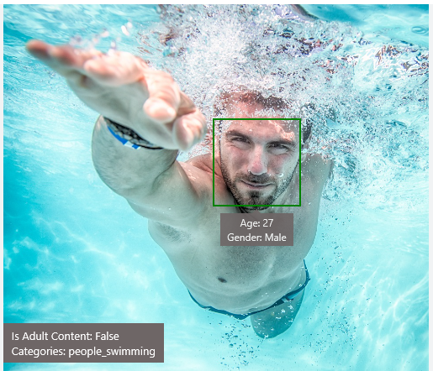
Analyze Image – Example
Type of Image:
Clip Art Type 0 Non-clipart
Line Drawing Type 0 Non-Line Drawing
Black & White Image False
Content of Image:
Categories [{ “name”: “people_swimming”, “score”: 0.099609375 }]
Adult Content False
Adult Score 0.18533889949321747
Faces [{ “age”: 27, “gender”: “Male”, “faceRectangle”: {“left”: 472, “top”: 258, “width”: 199, “height”: 199}}]
Image Colors:
Dominant Color Background White
Dominant Color Foreground Grey
Dominant Colors White
Accent Color

Slide 18
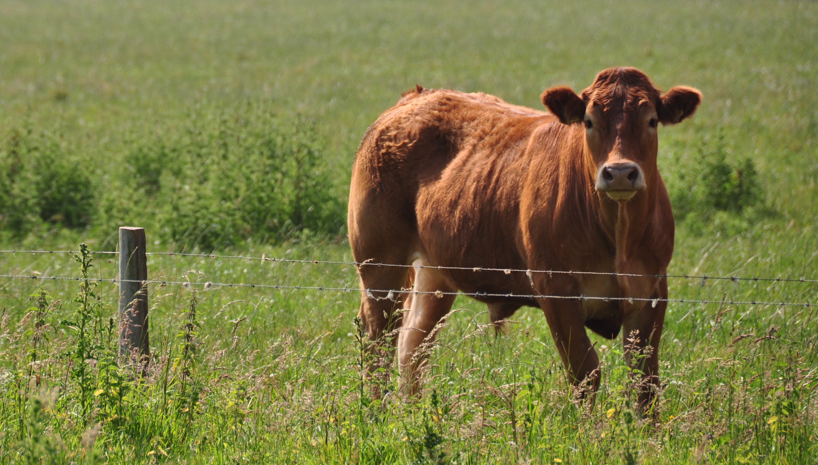
Analyze Image – Example
Categories v0: [{ “name”: “animal”, “score”: 0.9765625 }]
V1: [{ "name": "grass", "confidence": 0.9999992847442627 },
{ "name": "outdoor", "confidence": 0.9999072551727295 },
{ "name": "cow", "confidence": 0.99954754114151 },
{ "name": "field", "confidence": 0.9976195693016052 },
{ "name": "brown", "confidence": 0.988935649394989 },
{ "name": "animal", "confidence": 0.97904372215271 },
{ "name": "standing", "confidence": 0.9632768630981445 },
{ "name": "mammal", "confidence": 0.9366017580032349, "hint": "animal" },
{ "name": "wire", "confidence": 0.8946959376335144 },
{ "name": "green", "confidence": 0.8844101428985596 },
{ "name": "pasture", "confidence": 0.8332059383392334 },
{ "name": "bovine", "confidence": 0.5618471503257751, "hint": "animal" },
{ "name": "grassy", "confidence": 0.48627158999443054 },
{ "name": "lush", "confidence": 0.1874018907546997 },
{ "name": "staring", "confidence": 0.165890634059906 }]
Describe
0.975 "a brown cow standing on top of a lush green field“
0.974 “a cow standing on top of a lush green field”
0.965 “a large brown cow standing on top of a lush green field”

Slide 19
Wackcoon

Slide 20
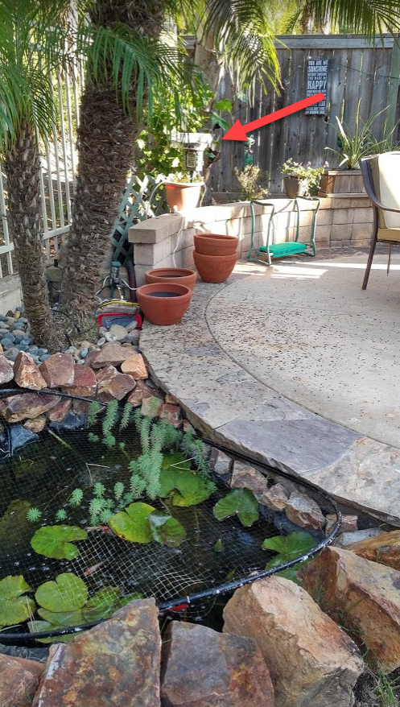
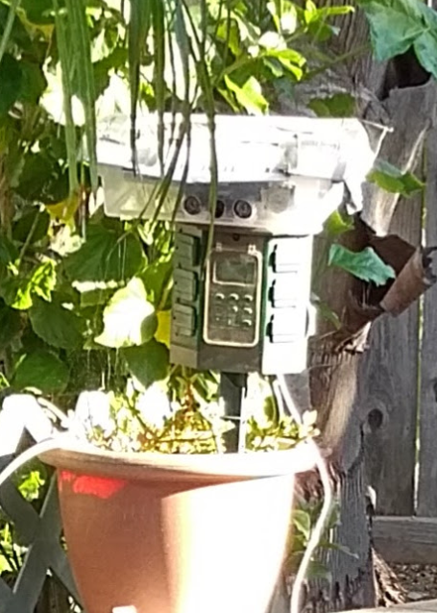
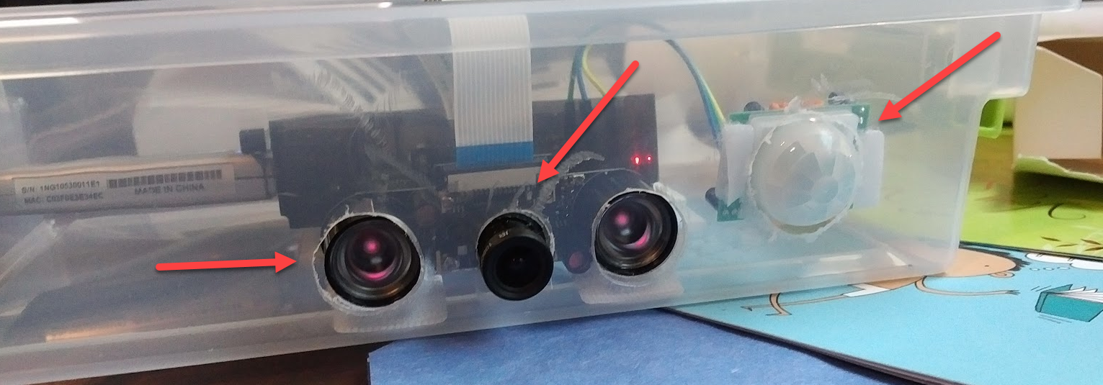
Wackcoon
Content of Image:
Categories v0: [{ “name”: “animal”, “score”: 0.9765625 }]
V1: [{ "name": "grass", "confidence": 0.9999992847442627 },
{ "name": "outdoor", "confidence": 0.9999072551727295 },
{ "name": "cat", "confidence": 0.99954754114151 },
{ "name": "raccoon", "confidence": 0.9976195693016052 },
{ "name": "grey", "confidence": 0.988935649394989 },
{ "name": "animal", "confidence": 0.97904372215271 },
{ "name": "standing", "confidence": 0.9632768630981445 },
{ "name": "mammal", "confidence": 0.9366017580032349, "hint": "animal" },
{ "name": "aquarium", "confidence": 0.8946959376335144 },
{ "name": "green", "confidence": 0.8844101428985596 },
{ "name": "grass", "confidence": 0.8332059383392334 },
{ "name": "water", "confidence": 0.5618471503257751 },
{ "name": "grassy", "confidence": 0.48627158999443054 },
{ "name": "lush", "confidence": 0.1874018907546997 },
{ "name": "staring", "confidence": 0.165890634059906 }]

Slide 21
Demo
microsoft.com/cognitive
Start coding
A simple bot using the vision API
We will go deeper about the BotFramework Later

Slide 22
Face APIs Detection
Verification
Grouping
Identification

Slide 23
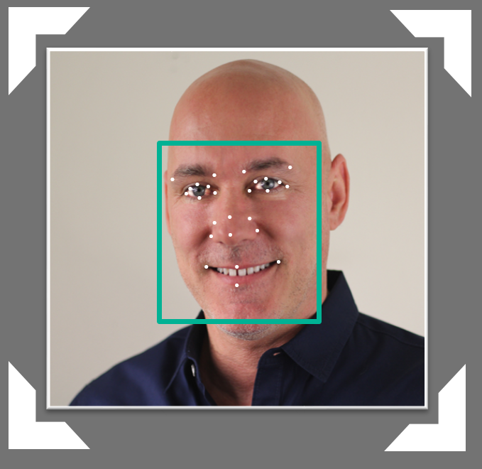

Face API – Detection
Detection Result:
JSON:
[
{
"faceRectangle": {
"width": 109,
"height": 109,
"left": 62,
"top": 62
},
"attributes": {
"age": 41,
"gender": "male",
"headPose": {
"roll": "2.9",
"yaw": "-1.3",
"pitch": "0.0"
}
"faceLandmarks": {
"pupilLeft": {
"x": "93.6",
"y": "88.2"
},
"pupilRight": {
"x": "138.4",
"y": "91.7"
},
...
DETECTION
ATTRIBUTES
INPUT IMAGE
FACIAL RECTANGLE + LANDMARKS

Slide 24
Face API – Detection
Detection Result:
JSON:
[
{
"faceRectangle": {
"width": 109,
"height": 109,
"left": 62,
"top": 62
},
"attributes": {
"age": 31,
"gender": "male",
"headPose": {
"roll": "2.9",
"yaw": "-1.3",
"pitch": "0.0"
}
"faceLandmarks": {
"pupilLeft": {
"x": "93.6",
"y": "88.2"
},
"pupilRight": {
"x": "138.4",
"y": "91.7"
},
...
.
.
.
.
.
.
.
.
.
.
.
.
.
.
.
.
.
.
.
.
.
.
.
.
.
.

Slide 25

Face API – Verification
Given two faces, determine whether they are the same person
Verification Result:
JSON:
[
{
"isIdentical":false,
"confidence":0.01
}
]
.
.
.
.
.
.
.
.
.
.
.
.
.
.

Slide 26
Demo
microsoft.com/cognitive
Start coding
Lets see the online API

Slide 27


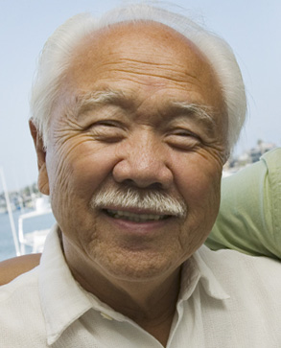

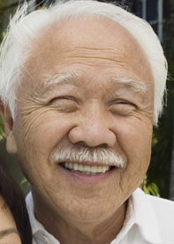

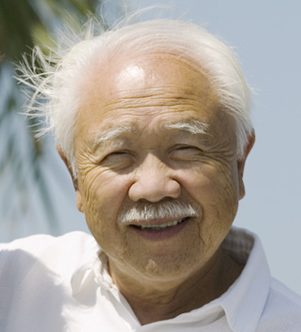

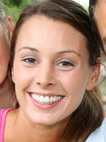
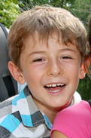
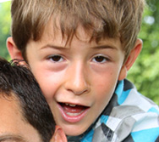
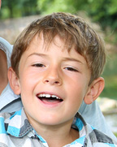
Face API – Grouping
CLUSTERED BY
DETECTED PEOPLE

Slide 28

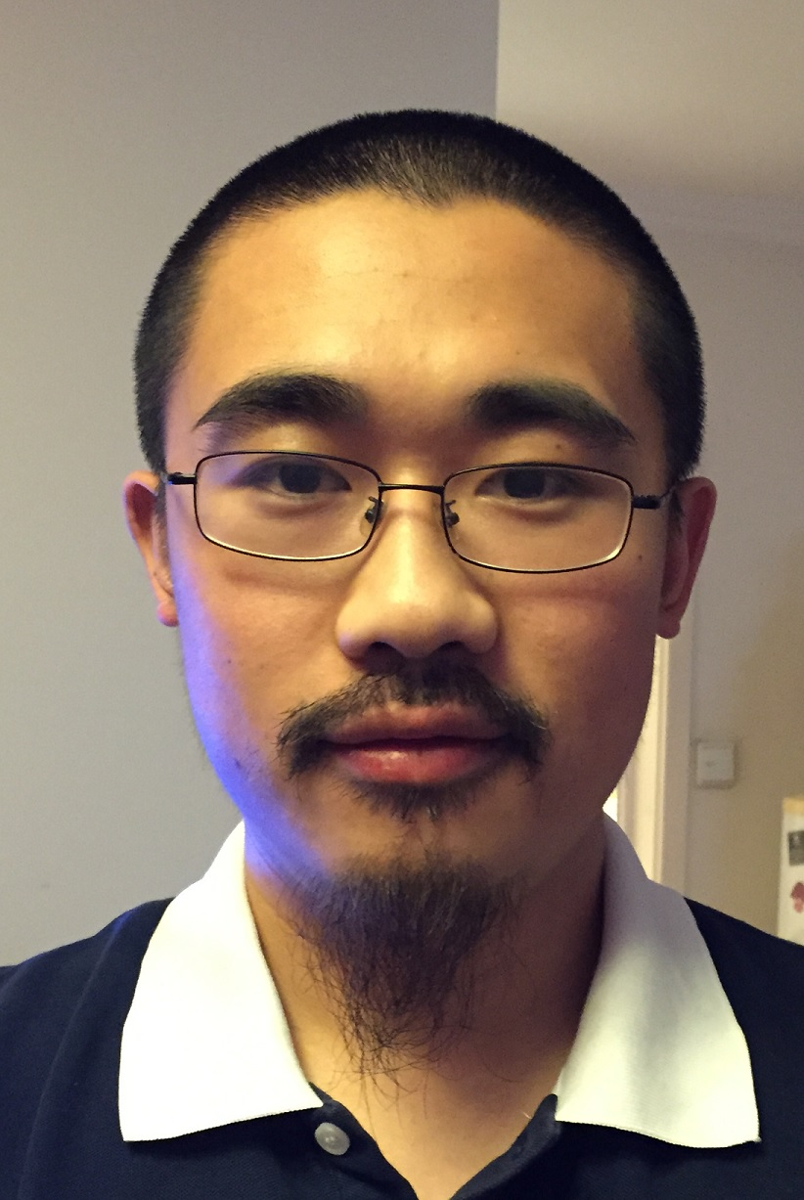


Face API – Create Person Object
DETECTION
INPUT IMAGE
FACIAL RECTANGLE + LANDMARKS
Daniel
Egan
Daniel Egan
COLLEAGUES
COLLEAGUES
COLLEAGUES
CREATE PERSON GROUP
ADD PERSON

Slide 29
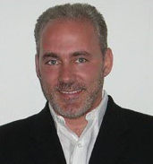


Face API – Identify
Natalie Huber
He is Daniel Egan.
IDENTIFY
GROUP PERSON OBJECTS
NEW INPUT IMAGE
RECOGNITION
Daniel Egan
COLLEAGUES

Slide 30
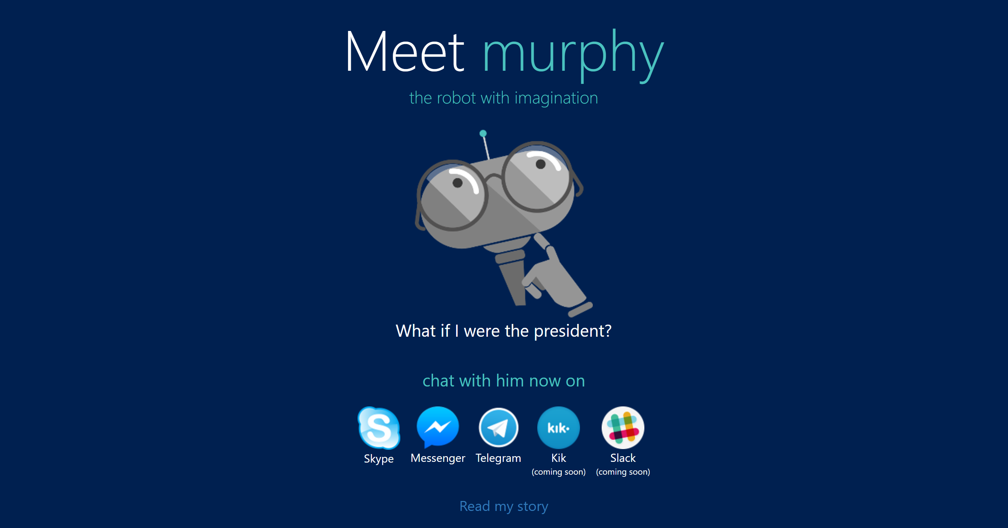

Slide 31
Back to LUIS
Natural Language Processing

Slide 33
What is NLP
NLP is a way for computers to analyze, understand, and derive meaning from human language in a smart and useful way.
Notes:
http://blog.algorithmia.com/introduction-natural-language-processing-nlp/
https://www.youtube.com/watch?v=8S3qHHUKqYk
Tons of stuff here : http://blog.algorithmia.com/introduction-natural-language-processing-nlp/
Human generated language.
spam detection
Millennial speak
On fleek
Bae
Dabbing
Yolo
Throwing Shade
To may, the ability of the computer to process language as skillfully as we do will signal the arrival of truly intelligent machines. The basis of this belief is the fact tht the effective use of language is intertwined with our general cognitive abilities. Among the first to consider the computational implications of this intimate connection was Alan Turing.

Slide 34
Why is NLP so hard?

Slide 35
“I saw a man on a hill with a telescope.”
Simple statement?
There’s a man on a hill, and I’m watching him with my telescope.
There’s a man on a hill, who I’m seeing, and he has a telescope.
There’s a man, and he’s on a hill that also has a telescope on it.
I’m on a hill, and I saw a man using a telescope.
Notes:
http://blog.algorithmia.com/introduction-natural-language-processing-nlp/
https://www.youtube.com/watch?v=8S3qHHUKqYk
Tons of stuff here : http://blog.algorithmia.com/introduction-natural-language-processing-nlp/
Human generated language.
spam detection
Millennial speak
On fleek
Bae
Dabbing
Yolo
Throwing Shade

Slide 36
Think about a bot used to answer customers questions about laptops and accessories.
Has my order number 15489 been shipped yet?
How fast is the Surface 3?
Do you sell Acer Laptops and drives?
What kind of a display is on Surface 4
Notes:
http://blog.algorithmia.com/introduction-natural-language-processing-nlp/
https://www.youtube.com/watch?v=8S3qHHUKqYk
Tons of stuff here : http://blog.algorithmia.com/introduction-natural-language-processing-nlp/
Human generated language.
spam detection
Millennial speak
On fleek
Bae
Dabbing
Yolo
Throwing Shade

Slide 37
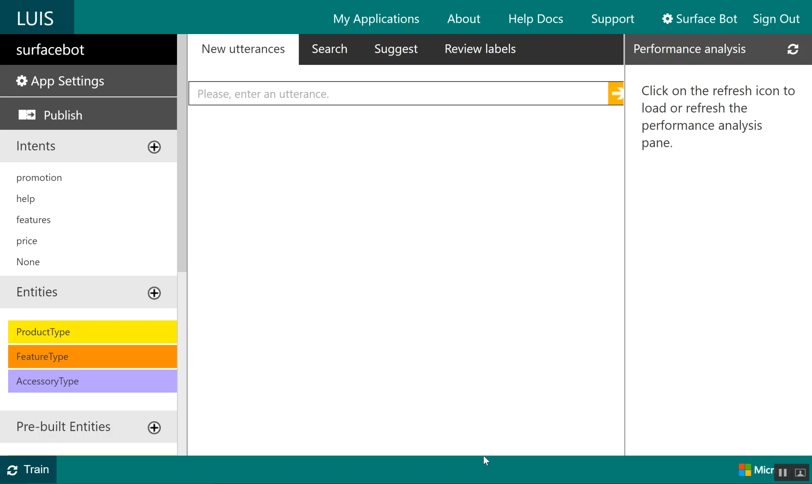

Slide 38
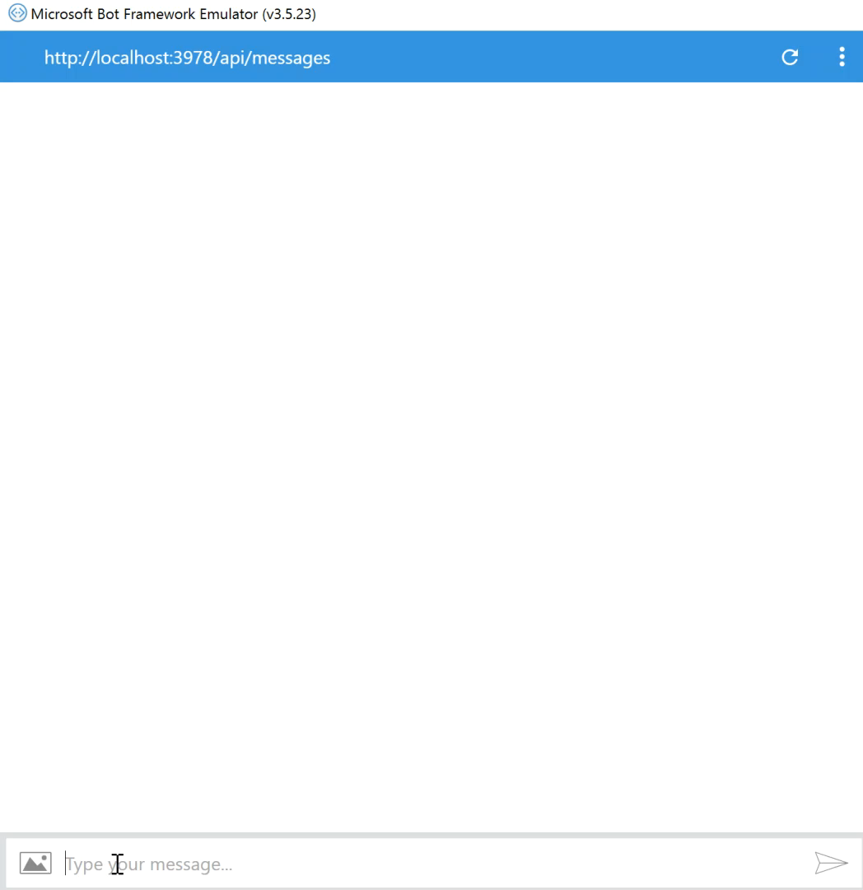

Slide 39
New bot developers tend to abuse NLP
A bot with a single dialog using 100 LUIS intents is a bad design:
One question
100 LUIS intents, * 100 different utterances per intent = 10000 different things users may say (plus the other 90000 possibilities you didn’t predict)
100 different things your bot can do
Users will only guess 3 or so
So you just wasted 97% of your code
Hello user! How can I help you?

Slide 40
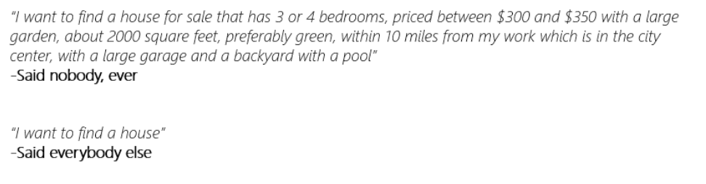
Users never say things the way you expect
As you model your NLP, make sure you’re being realistic

Slide 41
New bot developers tend to abuse NLP
So instead:
Hello user! How can I help you?
What events are you interested in?
What music would you like? (by the way, next time you could just type “I’m looking for a song named xyz” and I will know what to do)
Events
Music
Stages
Comedy
Amenities
Film
Laser Dome
Spectacles
Theater
Guide the user
Save time
Help the user discover what your bot can do

Slide 42
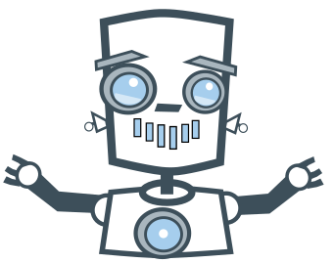
Directed or Non-Directed

Slide 43
Non -Directed
Directed

Slide 44
Non -Directed
Directed

Slide 45
How do I sign up?
How can you help me
Is there a warrantee?
What is a reserve price?
How long does the battery last?
I'm looking for cameras
Show me some shoes.
General Questions
Product Search
Product Details

Slide 46



Intent Recognizers
What they said
What they meant
Intent
Recognizer
Implements IIntent Interface

Slide 47
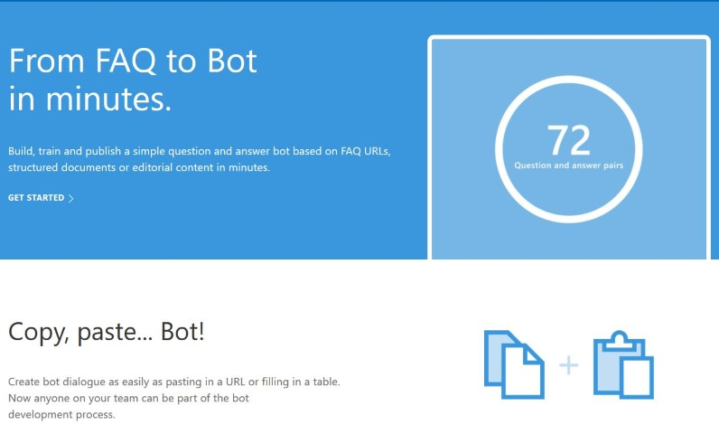

Slide 48
The Bot Framework

Slide 49
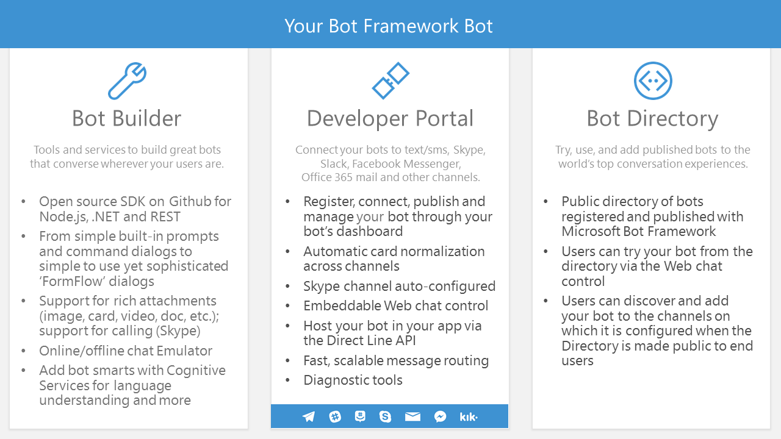

Slide 50
An x-ray of a typical bot
Conversation Canvas/Channels
Your code goes here
Web Chat
Bot Connector Service
Email
Message input <> output
State Management
Facebook
GroupMe
Your bot code
API, SDK calls
Kik
Skype
Bot Builder SDK
Slack
+ Microsoft Cognitive Services
Telegram
Other services, APIs,
Databases, Azure Machine Learning, Azure Search, etc…
Natural Language
Translation
Vision/Face
Emotion
Twilio (SMS)
…
Direct Line…
Speech
Entity Extraction
Search
Knowledge API
…
…
…

Slide 51











Bot Communication
User
Channel
Bot

Slide 52
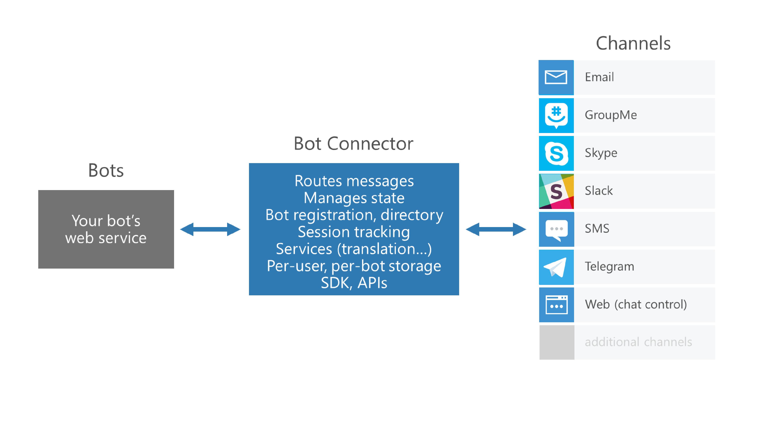

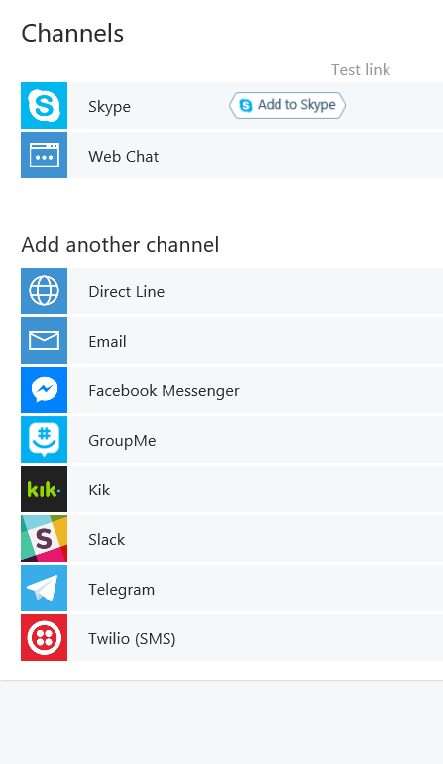

Slide 53



Connector Service
Connector Service
Bot
Channel
Activity JSON
Channel JSON

Slide 54
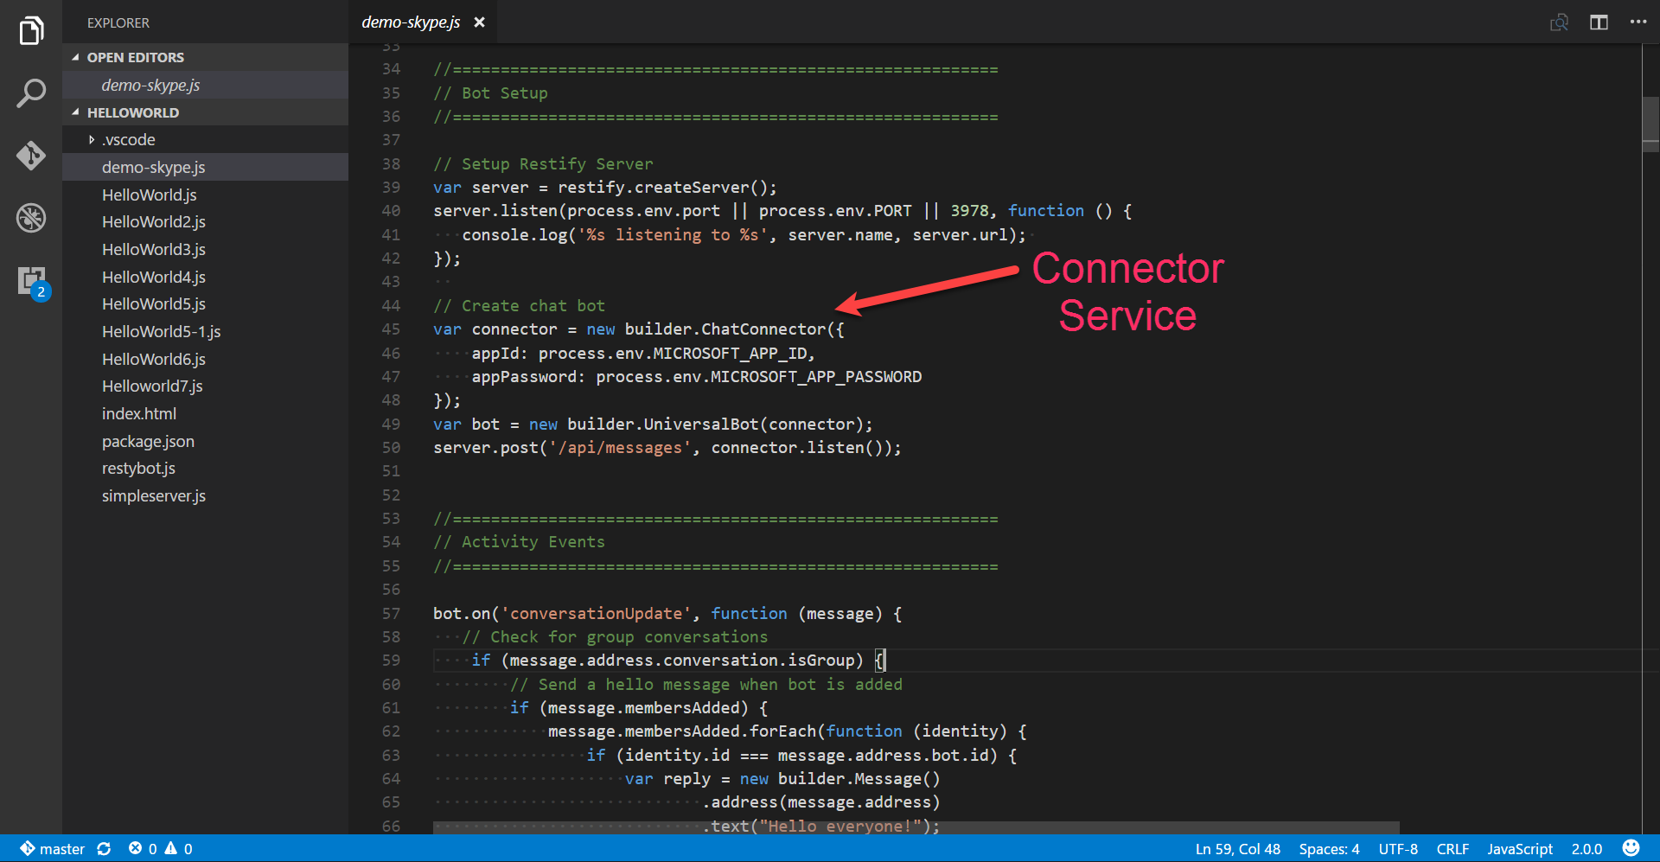

Slide 55

Dialogs
User
Bot
Hi
Hi I'm Dinner Bot how can I help you today?
I would like to reserve a table.
Great, lets get started.

Slide 56
Dialogs = Routing
Hi
How can I help you
I want to reserve a table
Do we know the user?
No
Yes
GetUserInfoDialog
ReservationDialog

Slide 57
Dialog Chain
Conversation
Introduction Dialog
User Info Dialog
Reservation Dialog
C# Chaining or Context.Call
node beginDialog/endDialog or waterfall

Slide 58
Persisting Data
userData
stores information globally for the user across all conversations.
conversationData
stores information globally for a single conversation. This data is visible to everyone within the conversation so care should be used to what’s stored there. It’s disabled by default and needs to be enabled using the bots persistConversationData setting.
privateConversationData
stores information globally for a single conversation but its private data for the current user. This data spans all dialogs so it’s useful for storing temporary state that you want cleaned up when the conversation ends.
dialogData
persists information for a single dialog instance. This is essential for storing temporary information in between the steps of a waterfall.

Slide 59
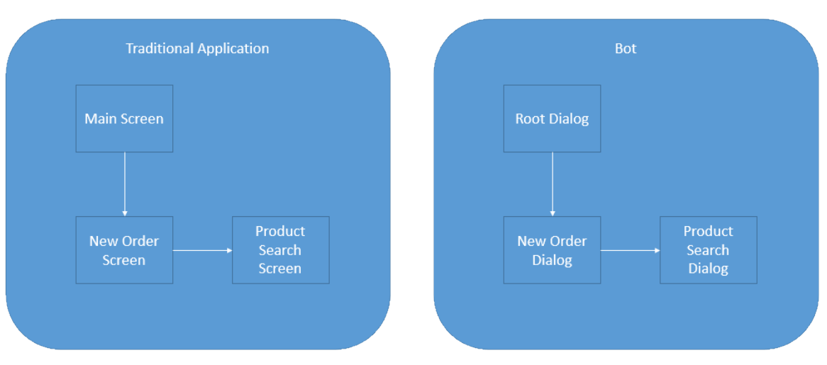
Dialogs are for bots like screens are for apps
They separate concerns and organize flows, exactly the same way:

Slide 60
Invoking a Dialog
var server = restify.createServer();
server.listen(process.env.port || process.env.PORT || 3978, function () { });
var connector = new builder.ChatConnector({
appId: process.env.MICROSOFT_APP_ID,
appPassword: process.env.MICROSOFT_APP_PASSWORD
});
var bot = new builder.UniversalBot(connector);
server.post('/api/messages', connector.listen());
// Root dialog
bot.dialog('/', ...

Slide 61
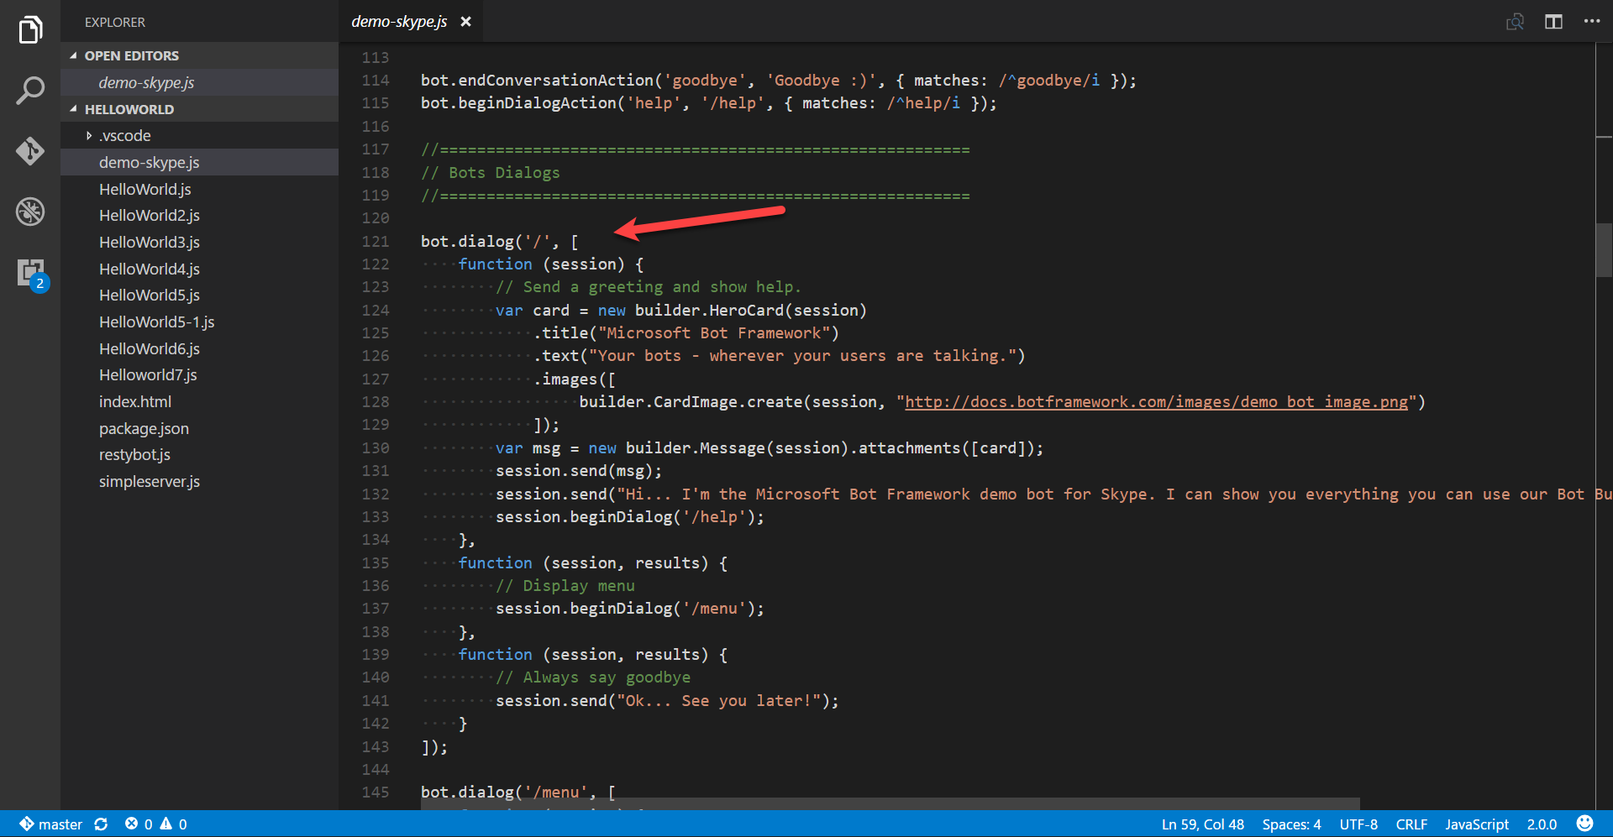

Slide 62
Dialogs are serialized into stacks
This is how we know how to navigate “back”
Users won’t necessarily think that way
…
Dialog 2
Dialog 1
Root Dialog

Slide 63
Redirecting to a Dialog
bot.dialog('/', new builder.IntentDialog()
//Did the user type 'order'?
.matchesAny([/order/i], [
function (session) {
//Let's invoke then the new order dialog
session.beginDialog('/newOrder');
},
function (session, result) {
//This will get us whatever the new order dialog decided to return to us
var resultFromNewOrder = result.response;
session.send('New order dialog just told me this: %s', resultFromNewOrder');
//We are now done with the root dialog
session.endDialog();
}
])

Slide 64
Redirecting to a Dialog
bot.dialog('/startCampaign', [
function (session, args, next) {
builder.Prompts.confirm(session, 'Do you already have a gift in mind?');
},
function (session, args, next ) {
if (args.response) {
builder.Prompts.choice(session, 'Is your gift from the website or elsewhere?', ['I found my gift the site', 'I found my gift from an external site', 'I didn\'t find my gift yet']);
} else {
session.send('That\'s okay, we can help you pick out the perfect gift! ');
return session.replaceDialog('/productSearch');
}

Slide 65
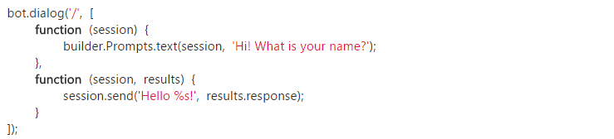
Waterfall
Exactly what it sounds like.

Slide 66
Simple Waterfall
var builder = require('botbuilder');
var connector = new builder.ConsoleConnector().listen();
var bot = new builder.UniversalBot(connector);
bot.dialog('/', [
function (session) {
builder.Prompts.text(session, 'Hi! What is your name?');
},
function (session, results) {
session.send('Hello %s!', results.response);
}
]);
Our root dialog '/'
Uses a text prompt to collect name
and put in session.
we use the result of the prompt
to echo back to user (notice that it
is an array of functions in the
dialog)

Slide 67
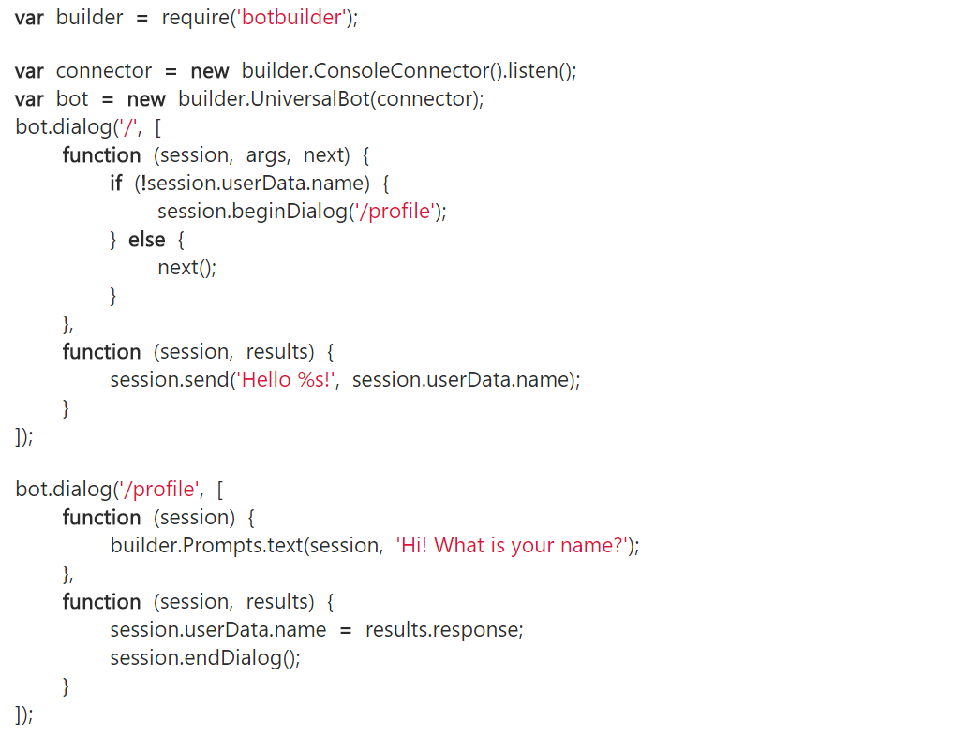
First Run
Nothing new here
Our root dialog '/'
Checks session.userdata
if no username sends to
our '/profile' dialog using
beginDialog()
We use a text prompt to collect
name
once data is collected we call
endDialog()

Slide 68
First Run
Our code flow returns here and
proceeds to the next function
We then address user by name
This whole dialog is not used
next time through

Slide 69
NEW First Run
var builder = require('botbuilder');
var connector = new builder.ConsoleConnector().listen();
var bot = new builder.UniversalBot(connector);
bot.dialog('/', function (session) {
session.send("%s, I heard: %s", session.userData.name, session.message.text);
session.send("Say something else...");
});
// Install First Run middleware and dialog
bot.use(builder.Middleware.firstRun({ version: 1.0, dialogId: '*:/firstRun' }));
bot.dialog('/firstRun', [
function (session) {
builder.Prompts.text(session, "Hello... What's your name?");
},
function (session, results) {
// We'll save the users name and send them an initial greeting. All
// future messages from the user will be routed to the root dialog.
session.userData.name = results.response;
session.endDialog("Hi %s, say something to me and I'll say it back to you.", session.userData.name);
}
]);
First Run Versioning

Slide 70
What else?

Slide 71
Prompt types
Prompts.text()
Prompts.confirm()
Prompts.number()
Prompts.time()
Prompts.choice()
Prompts.attachment()

Slide 72
Search can do wonders for bots
QnAMaker.ai:
Super low friction way of creating a Q&A bot
Built in web and document crawler: Parses data and builds the QnA easily
Not great for too many records
Not great for deep level customization of the experience
Azure Search:
Can work with millions of records like a breeze
Works with different document formats and data sources
Takes more effort to prepare/code/fine-tune

Slide 73
Others
First Run Conversation
First Run User
Proactive
Hand-off
Recommendation API
Directline
Middleware
Events

Slide 74
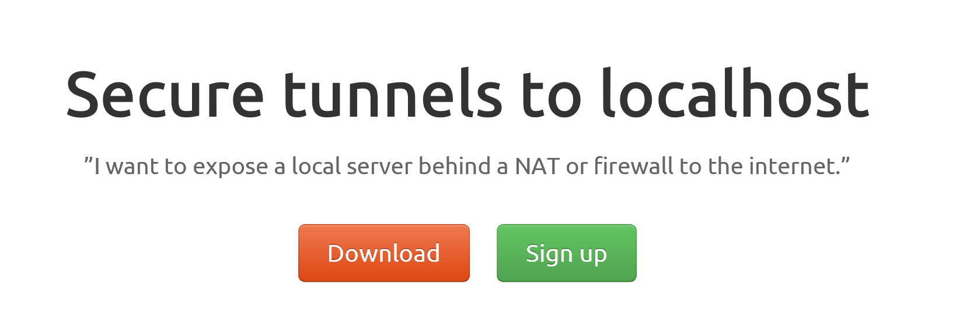
ngrok

Slide 75
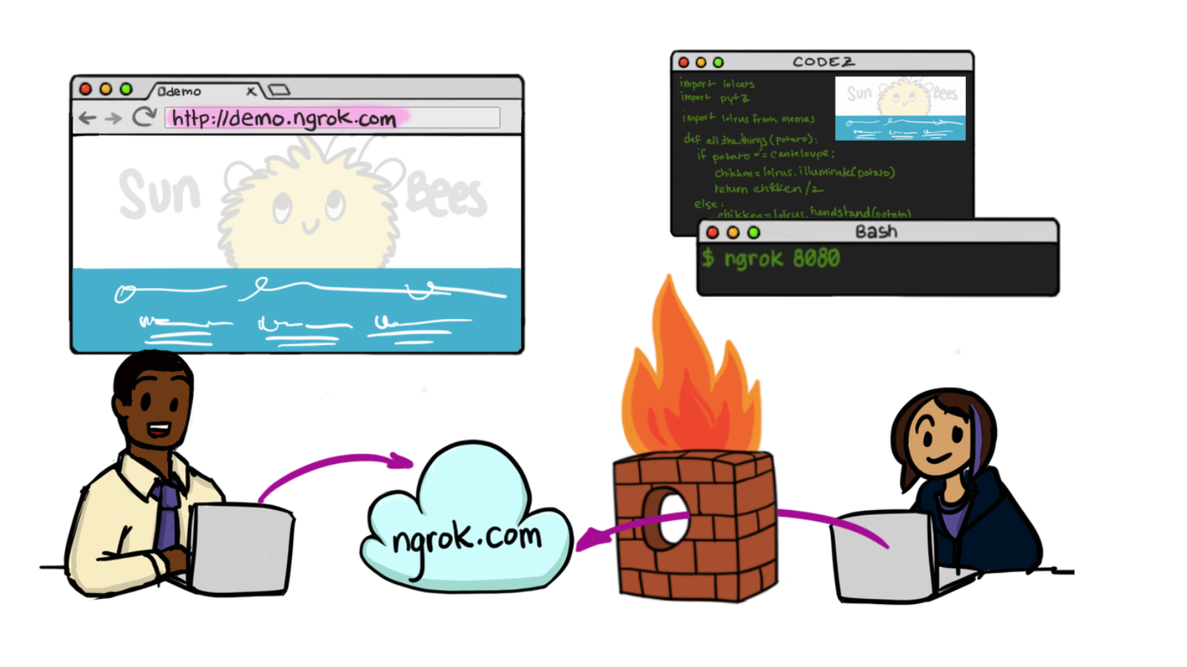

Slide 76
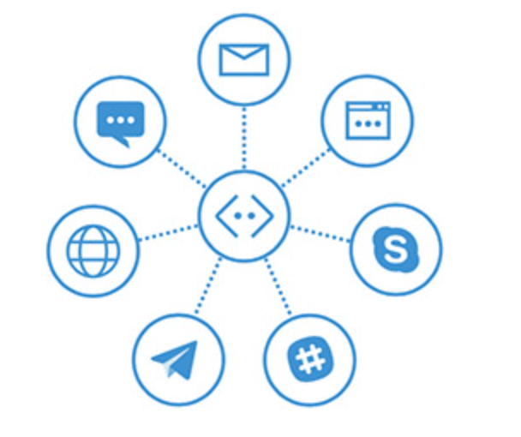
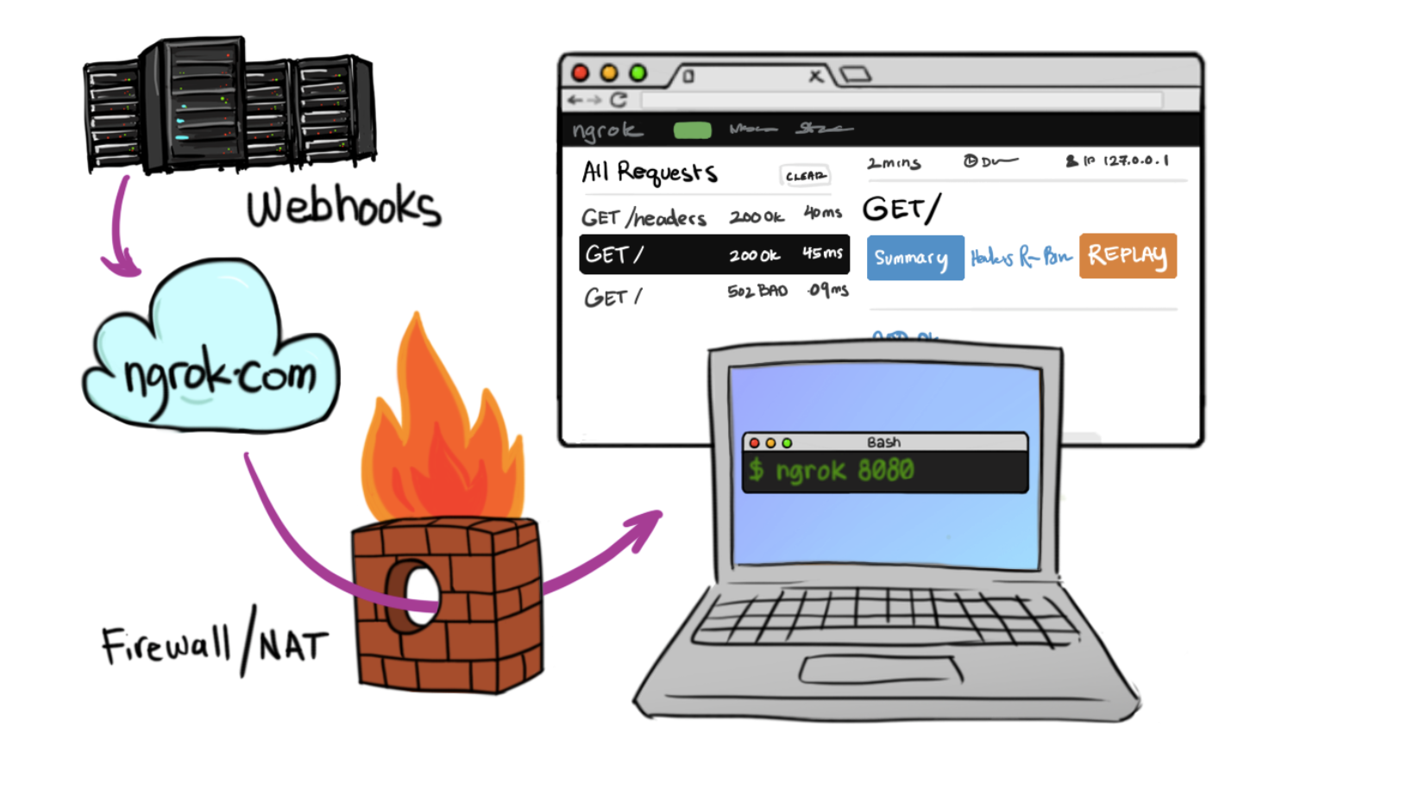
In Cloud
BotFramework

Slide 77
Additional Materials
https://docs.botframework.com/ - Bot Framework Docs
https://github.com/pveller/ecommerce-chatbot - Node – Implements IIntentInterface
https://github.com/Microsoft/BotBuilder - SDK’s has a samples folder
https://github.com/Microsoft/BotBuilder-Samples - Different Samples (Skype, Facebook, etc.)
https://www.luis.ai/Help - Training videos and HOL for LUIS
https://docs.botframework.com/en-us/tools/bot-framework-emulator/ Emulator download
http://aka.ms/bf-bc-vstemplate C# Bot Template
https://ngrok.com - Ngrok

